Slide 1

Software Testing & Quality (09)
Foreign-Language Testing

Slide 2
Highlights
General Concepts
Make the Words and Picture Make Sense
Translation Issue
Localization Issue
Configuration and Compatibility Issue
How Much Should You Test?

Slide 3
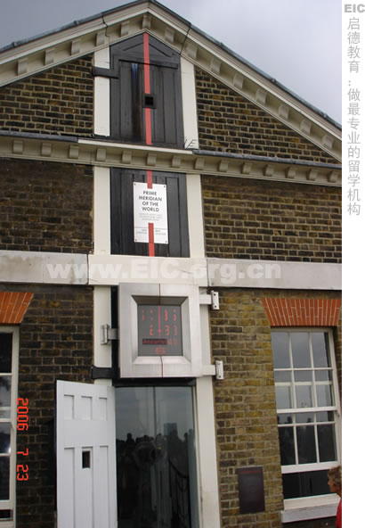
If you go aboard…
2/3/2009 = February 3,
or March 2?
Receive a E-mail, but
all is garbled ......

Slide 4
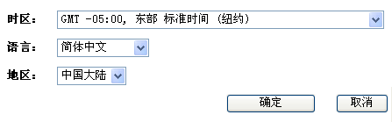
Example
中文简体、北京
  开始日期：2008年12月1日
  开始时间：8:00，中国标准时间 (GMT+08:00， 北京)
英文、纽约
  Starting date: Sunday, November 30, 2008
  Starting time: 7:00 pm, Eastern Standard Time (GMT-05:00, New York)

Slide 5
General Concepts
Translation - the language piece only
Internationalization - Designing and engineering a product so that it can be easily “localized”
Localization - Adapting an entire product for a specific “locale”
Globalization
How to make product to basic i18n support
Notes:
Internationalization：国际化
Globalization：全球化
全球化全球一个家。国际化往往是指合作。
I18N 是 internationalization 的缩写形式，意即在 i 和 n 之间有 18 个字母，本意是指软件的“国际化”；与之类似，L10N 是 localization 的缩写形式，意即在 l 和 n 之间有 10 个字母，本意是指软件的“本地化”。

Slide 6
i18N (internationalization)
is the process of designing an application so that it can be adapted to various languages and regions without engineering changes. Internationalization is the task of software developers
An internationalized program has the following characteristics:
  With the addition of localized data, the same executable can run worldwide
  Textual elements, such as status messages and the GUI component labels, are not hardcoded in the program. Instead they are stored outside the source code and retrieved dynamically
  Support for new languages does not require recompilation
  Culturally-dependent data, such as dates and currencies, appear in formats that conform to the end user's region and language
  It can be localized quickly
Notes:
Textual elements：文本元素

Slide 7
L10N (localization)
is the process of translating and adapting software to a particular language and culture for an already internationalized software. Localization need implementation translation of text, the change of UI, sounds and images, product testing
Roughly, i18N is considered an engineering process while L10N is considered a translation process
  Which part need consider Localization for a product?
  menu, dialog box, Hint, Alt text, Error message, static text etc
  Local & Time Zone & Date & Number & Currency & Measurements
  Shortcut key and Hotkey, Bitmap & Icon
  Installation Wizard
  Message Template, On-line help and samples
  Documentations (User's Manual, Tutorial, Installation Guide etc)
  Package outlook

Slide 8
G11N (Globalization)
Is a general term which is used to cover two different processes, internationalization and localization
G11N = I18N + L10N

Slide 9
G11N Testing
G11N testing is done in order to determine how well G11N has been done. For instance, will the product be easy to localize? Have all the localizable resources been separated from the source code? Does the software support Unicode?
GLOBALIZATION TESTING
INTERNATIONAL
SUPPORT
LOCALIZABILITY
TEST
Pseudo-translation
(Catalyst) is an
Important part
of G11N testing.
localizable resources externalized?
any regional settings hard-coded?
any concatenated strings?
do the RC files contain non-localizables (over-externalizing)?
text expansion allowed for?
text on non-layered graphics?
how many other components (icons, graphics, etc.) need to be adapted?
MBC characters and scripts?
MBC input and display?
MBC folder, file, data handled?
Regional settings?
Collation/sorting?
Run on localized OS?
Keyboard support?
MBC- Multiple Byte character

Slide 10
How to make product to basic i18n support
For web page: make sure all UI strings that need to be localized are enclosed within web tags
Example:
  A PHP code segment without tag:
    <?=$strMenuTitleFont?><NOBR>Attend a Meeting</NOBR><?=$strMenuTitleFont_End?>
  A PHP code segment with tag:
    <?=$strMenuTitleFont?><NOBR><WebTAG>Attend a Meeting</WebTAG></NOBR><?=$strMenuTitleFont_End?>
For client binary, all UI strings should be loaded from resource file, instead of hard-coded in the source code. The text might be used for display, search, comparison, etc

Slide 11
Translation Issue
Text Expansion
ASCII, DBCS, and Unicode
Hot Keys and Shortcuts
Extended Characters
Computations on Characters
Reading Left to Right and Right to Left
Text in Graphics
Keep the Text of the Code

Slide 12
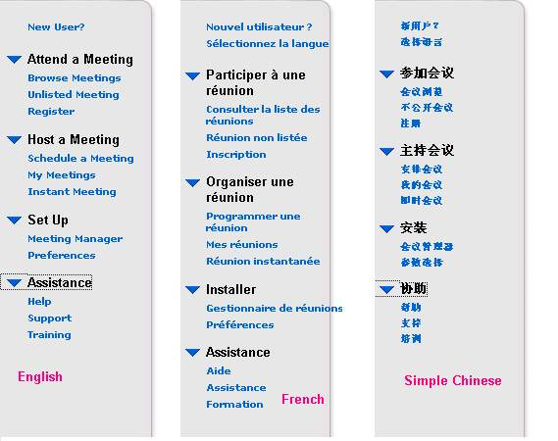
Translation Issue - Text Expansion

Slide 13
Translation Issue - DBCS
Set correct maximum length of text field on page and in database schema, to avoid any database access error
  1.Change the MAXLENGTH of Text to the half of the original
    e.g:
      Original: <INPUT TYPE="text" NAME="v_Address1" SIZE=39 MAXLENGTH=64>
      should be:<INPUT TYPE="text" NAME="v_Address1" SIZE=39 MAXLENGTH=32>
  2. Check the inputted char whether exceed the length before submit page

Slide 14
I18N Issues in web page
Layout and UI issue
Disorder code or garbled text
Char Index or Sort Issues
Full name difference between European and Asian

Slide 15
Localization Issue
Content
  The Content is all the other “stuff” besides the code that goes into the product. We should consider all the parts which make up a software product
Data Format
  Different locales use different formats for data units. So we need to become very familiar with the units of measure when we’re testing localized software

Slide 16
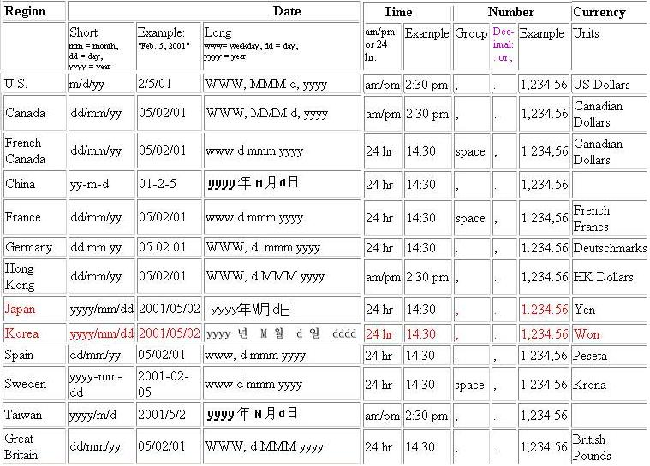
Localization Issue - Data Format

Slide 17
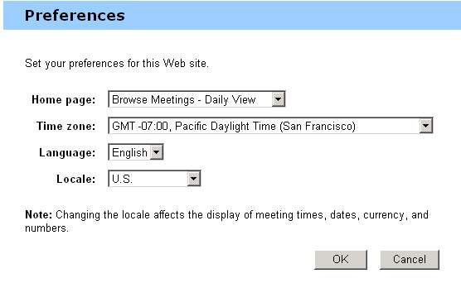
Example - Localization product
Region - The selected region determines the formats of numbers, currency, dates, and time on the Web pages.
Language - The default language for the Web pages, email messages, and client software

Slide 18
Configuration and Compatibility Issue
Localized OS - use to interact with
  Localized names of built-in elements OS
  Environment of your market
East Asian System locale
  Non-Unicode data path assumes single-byte text
European System locales
  OEM vs. Windows “ANSI”

Slide 19
How Much Should You Test?
Internationalization Testing
Localization Testing
Linguistic/Translation Testing
Cosmetic/UI Testing
Functionality Testing
More on Functionality Testing
Delivery Testing

Slide 20
L10n QA
L10n
QA
It is important to note that the software the localization vendor receives is already tested and working. Localization is all about preventing working code from being broken during the localization process. Localization is therefore dependent on rigorous testing as part of the Localization QA process
prevention
detection
Assurance
Procedures
Assurance
Testing
internationalization localization functionality

Slide 21
L10n Testing
LOCALIZATION TESTING
LINGUISTIC
COSMETIC
FUNCTIONAL
In-country testing
Translation verification testing (TVT)

Slide 22
Linguistic Testing
all text been translated?
accented chars handled properly?
punctuation rules of target?
target word wrap, hyphenation, sorting?
no truncations in dialogs?
consistency in terminology/usage?
all icons, graphics or sounds need to be adjusted?
are concatenated strings displayed properly?
have leading and trailing spaces been deleted, causing errors when strings are concatenated?
are strings with variables displaying properly?
are hot key and control key assignments consistent with OS standards?
Focuses on all the language elements of an application. Done (ideally) in running localized application. Uses test scripts ideally

Slide 23
Cosmetic (UI) Testing
all of the menus, options and commands of the original?
dialog boxes all properly resized?
all characters display properly?
did you test to see that all popup boxes, tool tips, balloons, status messages and dialogs fit on the screen at all resolutions?
when expanding and resizing, has alignment and size consistency been maintained?
hot keys unique?
has the tab order (if any) of the original been changed?
some controls (combo boxes, menus) have drop down elements, do they display properly?
do all the dialogs display the correct regional settings?
Focuses on all the visual elements of the UI. Done (ideally) in running localized application

Slide 24
Functionality Testing
did localization introduce any problems? All functions and features present?
can the localized and original versions save and open the same files?
do international keyboards and layouts work with the hot keys and control keys?
is the proper regional setting, keyboard, language the default?
does the clipboard preserve MBC and accented characters? Can they be cut and pasted to other applications?
does the application work on both the localized and original version of the OS?
do links to web and on-line help point to target language help?
do target language spell checkers, style checkers, dictionaries work?
does the localized version work on the hardware platform, with peripherals and accessories, drivers? Does the localized version interact with browsers and other programs properly?
Focuses on whether the application still works after localization. A well internationalized product will likely not fail functionality testing. Not a standard task, but done at vendor request with test scripts.

Slide 25
TVT and other testing
Translation verification testing (TVT)
  TVT ensures that the completed translation is contextually accurate, grammatically correct, and culturally appropriate. Certified linguists perform TVT
In-country testing
  Verifies "last mile" connectivity (local ISP, wireless, and DSL services) and functionality (localized disk images) through VeriTest's network of regionally based test resources in Europe and Asia
Release engineering
  VeriTest's Release Engineering services can dramatically reduce time-to-market. VeriTest software engineers can identify and correct many defects during the globalization testing process, and deliver gold master builds for release-to-market

Slide 26
More on Functionality Testing
Seldom done as part of localization process. Cannot overcome lack of thorough internationalization testing!
  Duplication of source-language test scripts and routines required
  Special attention paid to locale-specific components and issues
  Need to create complete testing environments, client/server applications and hardware
  Client proprietary tools
  Test scripts
  integration testing: testing two localized products or components together to see how they work
  performance testing: how does the product (web site?) work under heavy load
A localization vendor that has the capability of doing a comprehensive functionality test Suite can prdouce a so-called “gold master” of the localized software. This product can be manufactured and distributed as is

Slide 27
Delivery Testing
Are the folders and files correct in number and location?
Are all files in the specified formats and on the specified media?
Are there the same number of files in the original and in the target?
Has the installer and uninstaller been localized and tested?
Are all the versions of files and components the correct and latest versions?
Is the distribution media folder structure identical to the source?
Have all files been virus checked?
Focuses on ensuring that all the client required deliverables were provided according to project specifications.

Slide 28
Exercise
Software Testing, Page 168: 4, 6
  Identify several areas where extended characters can cause
  Name a few types of data formats that could vary from one localized program to another

